Slide 1
Mitron Bank Credit card Analysis
Aditya Barakoti
Code Basics Resume Challenge

Slide 2
Presentation Layout
Problem Statement
Objective
Analyze Report
Insights
Recommendation

Slide 3
Problem Statement
Mitron Bank, a legacy financial institution headquartered in Hyderabad, is gearing up to introduce new line of credit card offerings. Atliq Data Services proposed a collaborative partnership to analyze customer data and derive insights for designing the credit card product and formulating a data-driven marketing strategy. Mitron has greenlit a pilot study, sharing data on around 4000 customers and their spending habits over six months with Atliq.

Slide 4
Objective
Primary objective is to enhance Mitron Bank's credit card offerings and extend its market reach within the dynamic financial landscape, focusing on demographic diversification and spending pattern habits. The goal is to empower them to tailor credit card offerings in alignment with customer needs and prevailing market trends. Provide data-driven recommendations to Mr. Bashnir Rover & his team.

Slide 5
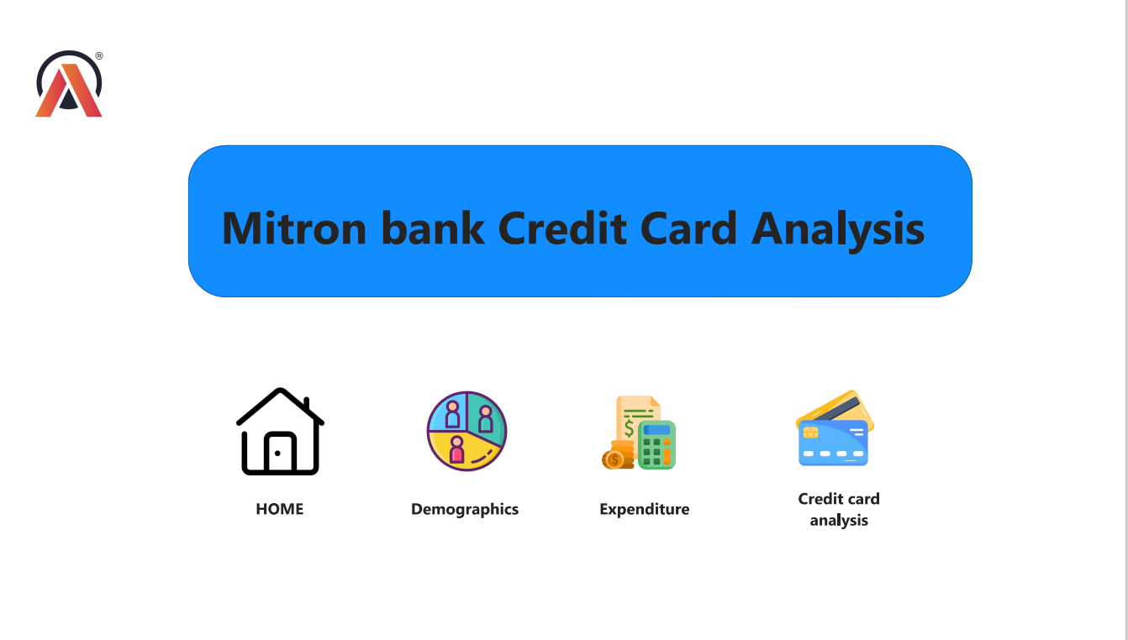

Slide 6
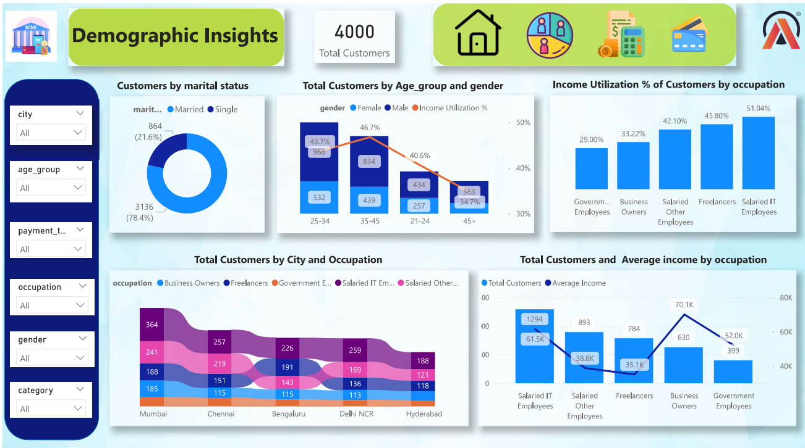

Slide 7
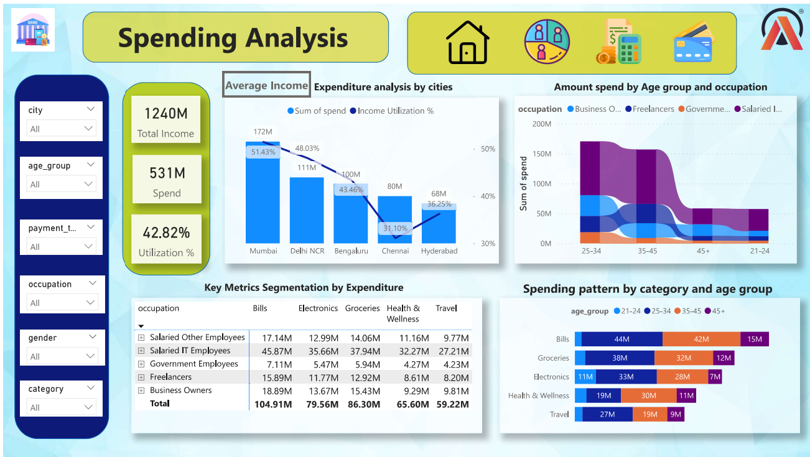

Slide 8
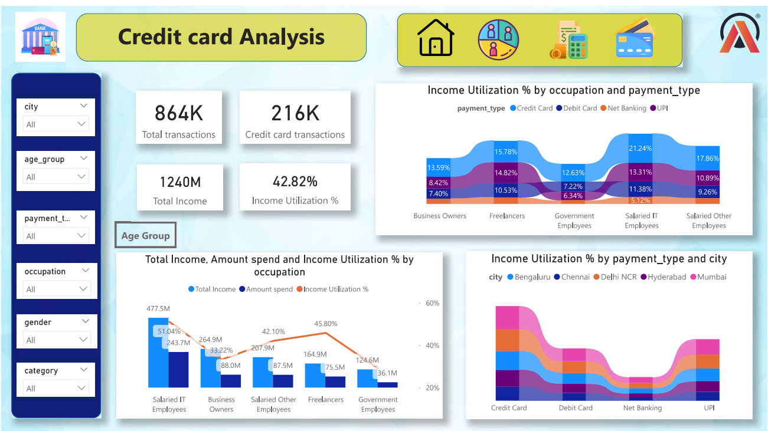

Slide 9
INSIGHTS
Leading spending categories include Bills, Groceries, Electronics, and Health & Wellness.
Mumbai stands out as a crucial spending center, reflecting diverse preferences across age groups.
Salaried IT Employees, Business Owners, and Freelancers display notable spending and higher income levels.
Age brackets 25-34 and 21-24 exhibit potential for heightened spending in Entertainment, Apparel, and Travel.
Age Bracket 35-45 holds the highest income utilizations % among all age groups.
Older age groups (45+) show a tendency for reduced credit card usage across various spending categories.
Mumbai leads in elevated credit card usage across diverse age groups and spending categories.
Other cities like Delhi NCR, Bengaluru, and Chennai exhibit distinct spending patterns across different age segments.
Male customers exhibit a higher inclination for credit card usage compared to females.
Married individuals demonstrate significantly greater credit card usage compared to their single counterparts. Additionally, categories like Bills, Electronics, and Travel offer opportunities for tailored credit card benefits or rewards, reflecting their substantial spending significance.
Aditya Barakoti
Code Basics Resume Challenge

Slide 10
RecommendationS
Roll out a cashback and reward points initiative for Mumbai residents, focusing on prevalent spending areas like bills, groceries, electronics, and health wellness to cater to their distinctive consumption patterns.
Launch exclusive travel-related offers and discounts for Mumbai customers, recognizing their significant outlays on travel expenses.
Create a range of tailored offers in electronics, entertainment, and travel for the 25-34 age group, tapping into their higher credit card usage and diverse spending behaviors.
Consider elevating credit card limits for salaried IT employees, acknowledging their substantial total income and notable spending trends.
Develop personalized cashback and reward programs for business owners, aligning with their specific business-related expenses and transactions.

Slide 11
6. Craft rewards and cashback offers targeting male customers, aligning with their spending preferences and habits.
7. Acknowledge the substantial presence of married couples in our customer base and introduce family-centric offers, such as incentives for family outings, groceries, or utility bill payments.
8. Extend higher cashback rates or rewards points specifically tailored for utility bills, recognizing their significance as a substantial spending category.
9. Introduce enticing EMI schemes and flexible payment alternatives targeted at facilitating convenient transactions for high-value electronic purchases.
10. Roll out exclusive offers, discounts, or rewards tailored for travel-related expenses to incentivize increased card usage within this category.

Slide 12
THANK YOU

